Slide 1
Lost in Translation?
Evaluating QA and Machine Translation Across Indic Languages with SQuAD Dataset
Andrew John J, Laxmi Vatsalya Daita, Adithya Hassan Hemakantharaju, Shamsvi Balooni Khan, Ab Basit Rafi Syed
CSE 842
Natural Language Processing

Slide 2
Lost in Translation?
Index
01
Introduction & Dataset
02
Machine Translation - NLLB-200
03
Model - 1 - (Andrew)
04
Model - 2 - (Aditya)
05
Model - 3 - (Shamsvi)
06
Model - 4 - (Ab Basit Syed)
07
Model - 5 - (Vatsalya) & Summary

Slide 3
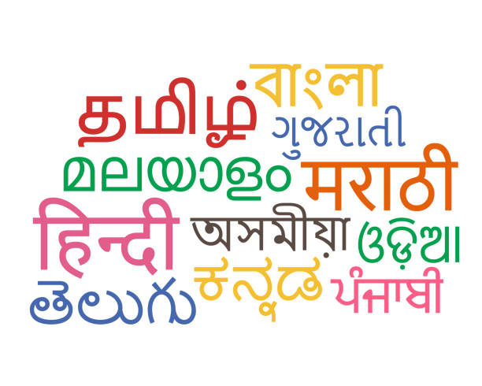
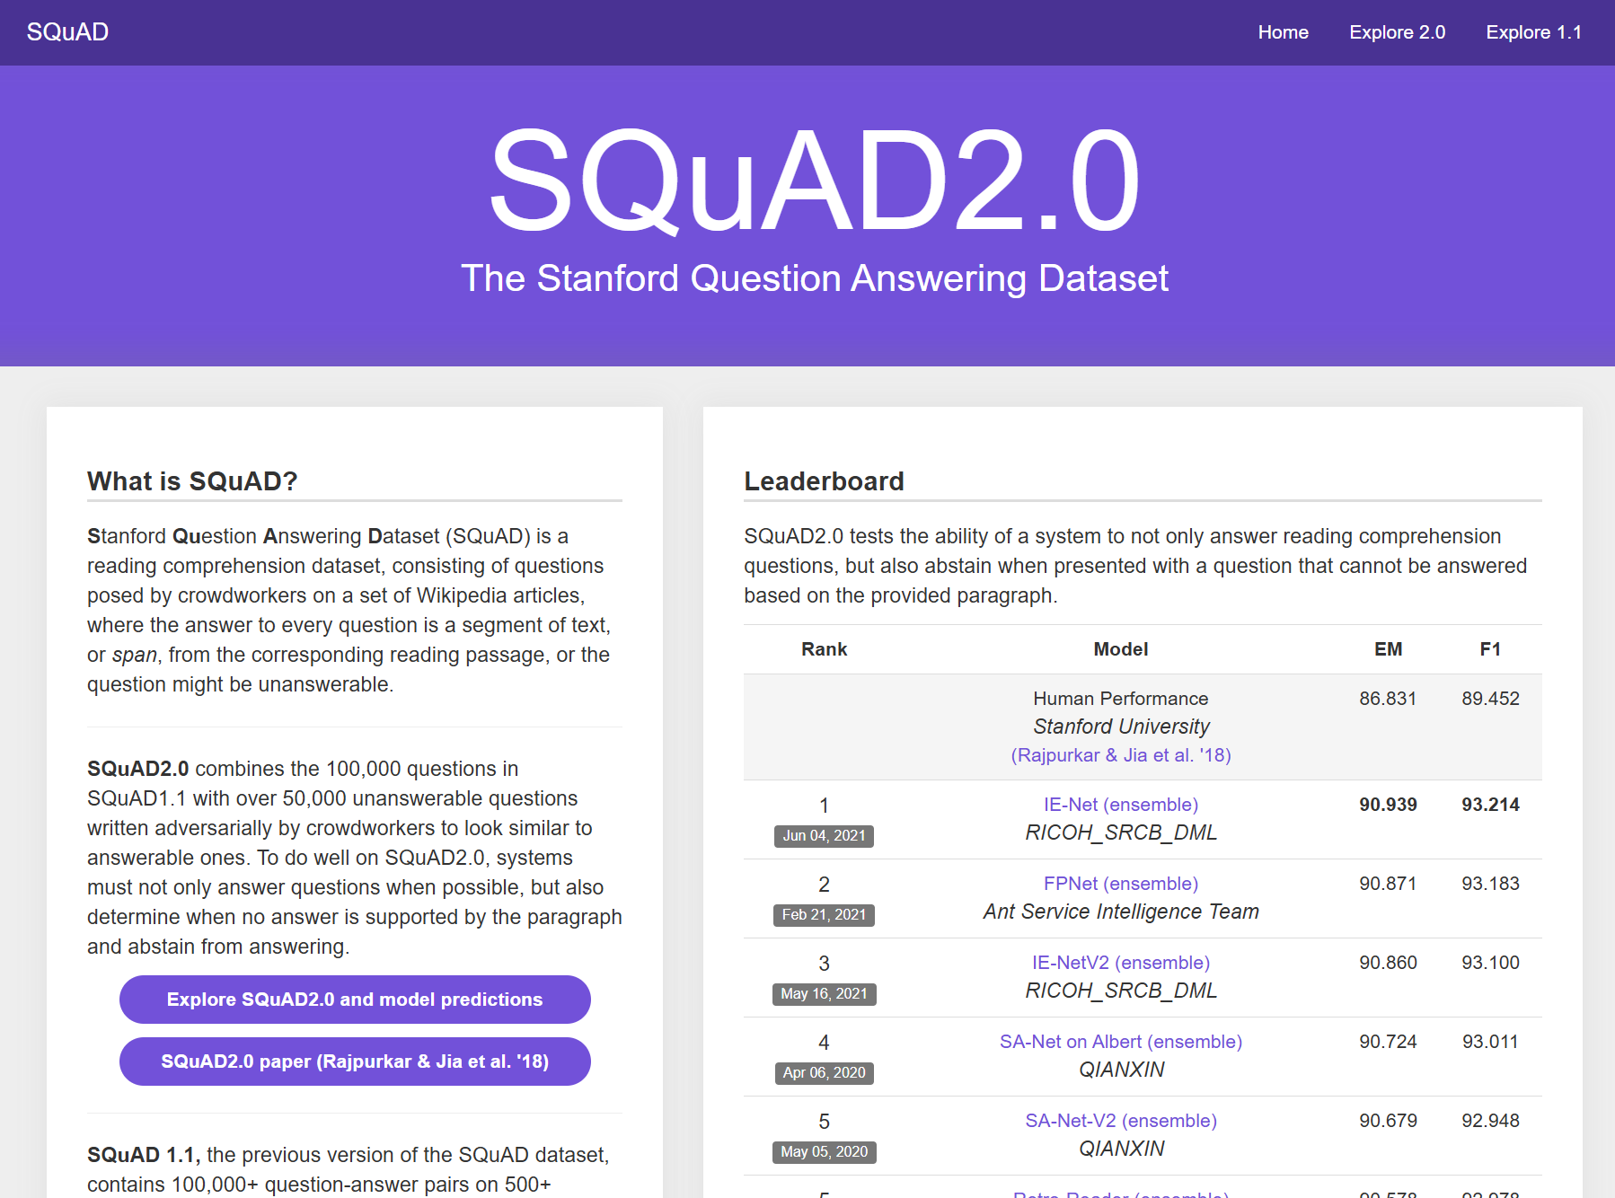
Lost in Translation?
Introduction & Dataset
Research Gap: SQuAD drove English QA to near-human performance, but systematic evaluation frameworks for Indic languages remain limited despite 800M+ speakers across morphologically rich language families (Dravidian, Indo-Aryan, Perso-Arabic script)
Our Approach: Comprehensive benchmarking of translated SQuAD v2.0 across 5 major Indic languages (Tamil, Hindi, Telugu, Kannada, Urdu) evaluating 5 state-of-the-art architectures (XLM-RoBERTa, LaBSE, MuRIL, Gemma2, mT5)
Research Objectives: Establish baseline performance metrics, quantify translation-induced degradation, and identify linguistic features (morphological complexity, script-specific issues, answer span alignment) that create barriers for cross-lingual QA systems
SQuAD v2.0 Foundation: 130,319 training + 11,873 development samples from 442 Wikipedia articles, with 50% unanswerable questions requiring models to distinguish valid answers from impossible questions
Translation Approach: NLLB-200 distilled 600M model translated all components (contexts, questions, answers, plausible answers) across Tamil, Hindi, Telugu, Kannada, and Urdu with language-specific batch processing (8-512 samples) and GPU optimization

Slide 4
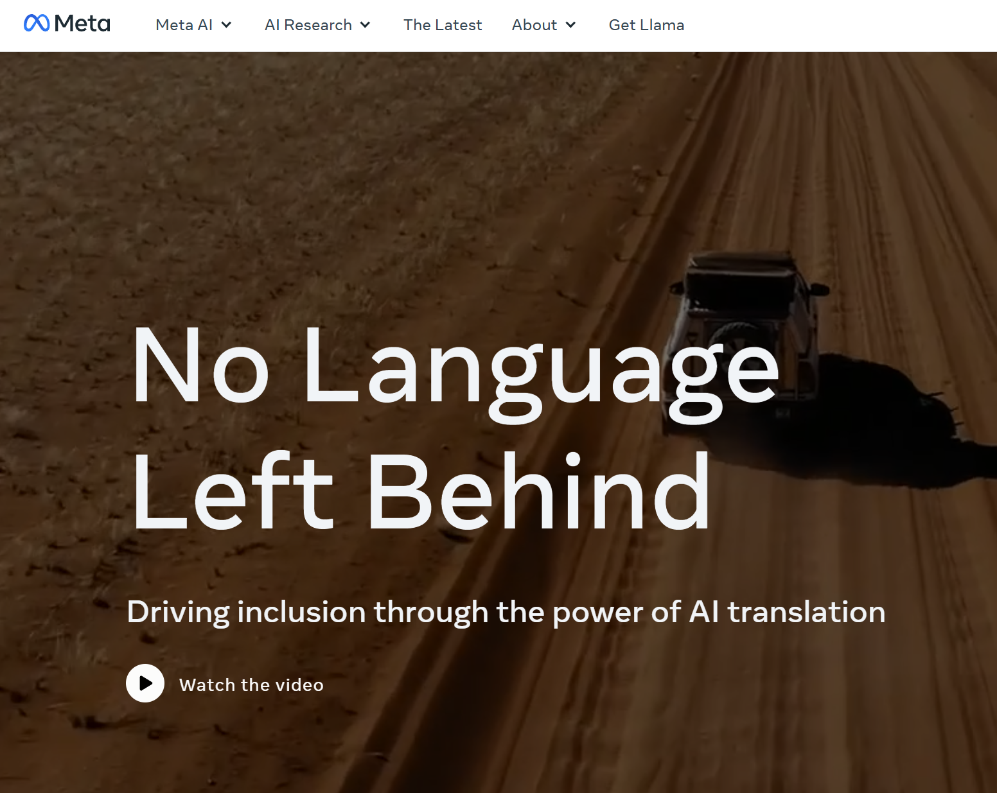
Lost in Translation?
No Language Left Behind - 200 - Meta
No Language Left Behind
NLLB-200 Model: Meta's 600M parameter model for 200 languages, translating contexts, questions, answers, and plausible answers across all Indic target languages
Tamil: RTX 4070 8GB with 34-chunk thermal-safe strategy, batch 64, 30-35 hours runtime achieving 100% script coverage and 90%+ accuracy with 1.04-1.05x expansion
Kannada: 40GB GPU with FP16, batch 512, seq 512 tokens, 130,319 samples revealing agglutinative patterns (120 words English → 79 words Kannada)
Telugu: Shared 40GB GPU with Kannada, full translation completed, evaluation pending, pivoted to Gemma2 on Kannada due to resource constraints
Hindi: Google Colab T4 GPU, batch 8, seq 512, 130,319 samples with strong entity preservation and successful named entity transliteration
Urdu: eng_Latn→urd_Arab codes, PyTorch/Transformers pipeline, RTL challenges revealed (question truncation to 1-2 chars, 24% contexts >800 chars)

Slide 5
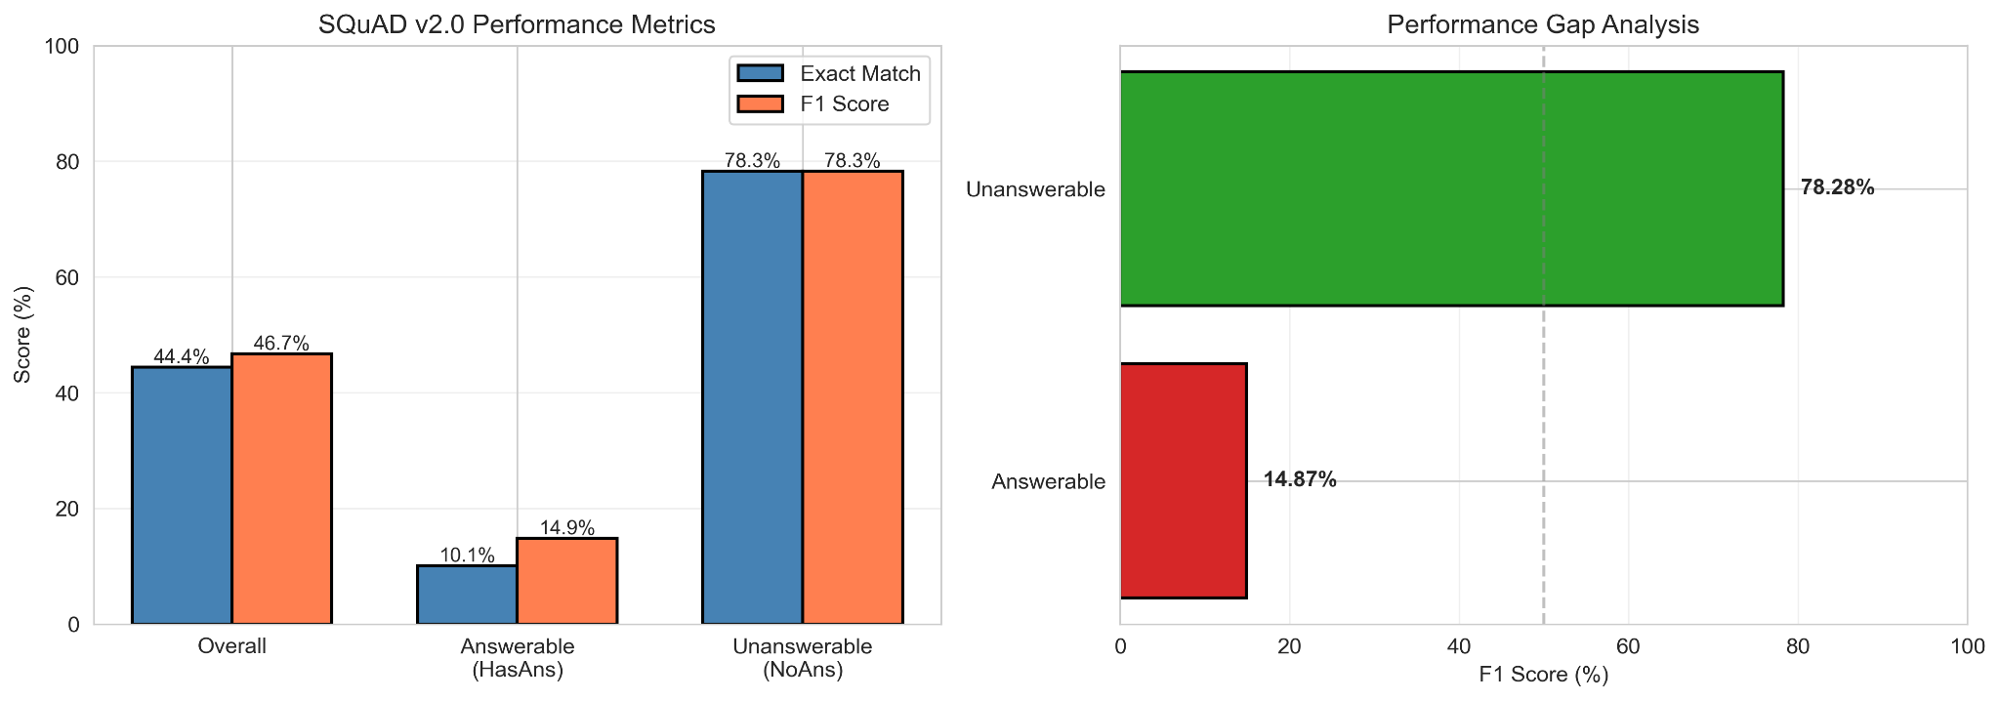
Lost in Translation?
Model - 1 - XLM RoBERTa - Tamil
Pre-processing and Modelling
Thermal-Safe Pipeline: 34-chunk translation strategy with 15-min cooling breaks, 30-35 hours runtime on RTX 4070 8GB GPU
Translation Quality: 100% Tamil script coverage, 90%+ accuracy, consistent 1.04-1.05x length expansion ratio
Model Architecture: XLM-RoBERTa-base 270M parameters pretrained on 100 languages with limited Tamil exposure
Training Configuration: 3 epochs, learning rate 5×10⁻⁵, batch size 16, AdamW optimizer with linear scheduling
Critical Preprocessing: find_answer_position() function for character-level start positions, JSON format conversion maintaining article-paragraph-QA hierarchies
Performance Asymmetry: 14.87% F1 on answerable vs 78.28% on unanswerable questions (63-point gap), with 64.67% false negative rate and conservative "no answer" bias
Length-Dependent Degradation: Performance drops from 26.5% F1 for short answers (1-10 chars) to near-zero for long answers (100+ chars), and from 15.7% F1 for short contexts to 7.2% for long contexts
Root Cause Discovery: 23% of translated answers don't exist as exact substrings in contexts due to independent translation creating morphological mismatches—explaining the learned conservative behavior

Slide 6
SWOT
Lost in Translation?
Inference, Insights & Results
STRENGTHS
OPPORTUNITIES
Strong unanswerable question performance (78.28% F1, 100% precision)
Root cause identified: 23% answer misalignment from independent translation
Comprehensive performance documentation across question types, answer lengths, context lengths
WEAKNESSES
Post-processing fixes: fuzzy matching (85% threshold) could recover 15-20% misaligned answers
Language-specific models: Tamil-aware tokenization, Dravidian language pretraining
Alternative approaches: generative QA, character-level modeling, hybrid semantic+span extraction
THREATS
Critical answer extraction failure (14.87% F1 answerable, 64.67% false negative rate)
Translation misalignment: 23% answers don't exist as exact substrings in contexts
Limited Tamil exposure in XLM-RoBERTa pretraining, struggles with agglutinative morphology
Data quality ceiling: 23% broken examples create performance upper bound
Morphological complexity: Tamil agglutination creates systematic tokenization challenges
Low-resource limitations: Tamil underrepresented in multilingual models, NLLB-200 translation bottlenecks

Slide 7
Lost in Translation?
Model - 2 - MuRIL - Kannada
Linguistic Patterns Discovered
Word vs Character Compression
Contexts: 120 words (EN) → 79 words (KN) [34% reduction]
But: 755 chars (EN) → 684 chars (KN) [only 9% reduction]
Insight: Kannada uses longer compound words with extensive suffixation
Question Translation
10 words (EN) → 7 words (KN)
Character length nearly identical: 58.5 vs 57.7
Demonstrates morphological compactness
Answer Consistency
Character length stable: ~13-14 chars in both languages
Factual answers remain concise across languages
Morphological Challenge
Single Kannada word = multi-word English phrase
Example: "ಕರ್ನಾಟಕದಲ್ಲಿ" = "in Karnataka"
Translation Methodology
Infrastructure Setup
NLLB-200 Distilled 600M model
40GB NVIDIA A100 GPU
Batch size: 512 samples
FP16 mixed-precision inference
Max sequence length: 512 tokens
Translation Scope
130,319 training samples translated
Four components per sample:
  Context passages
  Questions
  Answer texts
  Plausible answers
Quality Validation
Preserved 66.62% answerable / 33.38% unanswerable distribution
No pathological length expansion
High semantic fidelity maintained

Slide 8
SWOT
Lost in Translation?
Inference, Insights & Results
Model Performance
English Model (MuRIL)
Exact Match: 64.95%
F1 Score: 79.10%
Kannada Model (MuRIL)
Exact Match: 40.21%
F1 Score: 55.97%
Performance Gap
EM Drop: 24.74%
F1 Drop: 23.13%
Test Set Size
English: 13,023 samples
Kannada: 5,422 samples
Error Patterns
English Model Errors
Boundary errors: 35%
Semantic confusion: 28%
Unanswerable detection: 22%
Other: 15%
Kannada Model Errors
Complete misalignment: 42%
Tokenization issues: 23%
Unanswerable detection: 20%
Morphological variation: 15%
Critical Issue: 42% complete misalignment suggests fundamental encoding problems
Question Length Analysis
Short Questions (0-5 words)
English: 58.2%
Kannada: 38.7%
Gap: 19.5%
Medium Questions (6-10 words)
English: 60.0%
Kannada: 40.5%
Gap: 19.5%
Long Questions (20+ words)
English: 53.8%
Kannada: 33.3%
Gap: 20.5%
Key Finding: Consistent ~20% gap across all lengths
Key Challenges
Morphological Complexity
Agglutinative word formation
Tokenizer fragments compounds
Disrupts semantic coherence
Translation Drift
8-12% proper nouns mistranslated
"Queen Victoria" → "ರಾಣಿ ವಿಕ್ಟೋರಿಯಾ" (adds title)
Numerical formatting variations
Syntactic Differences
Different interrogative structures
Question particles & verbal inflections
Cannot transfer English attention patterns
Implication: Linguistic distance matters more than dataset size

Slide 9
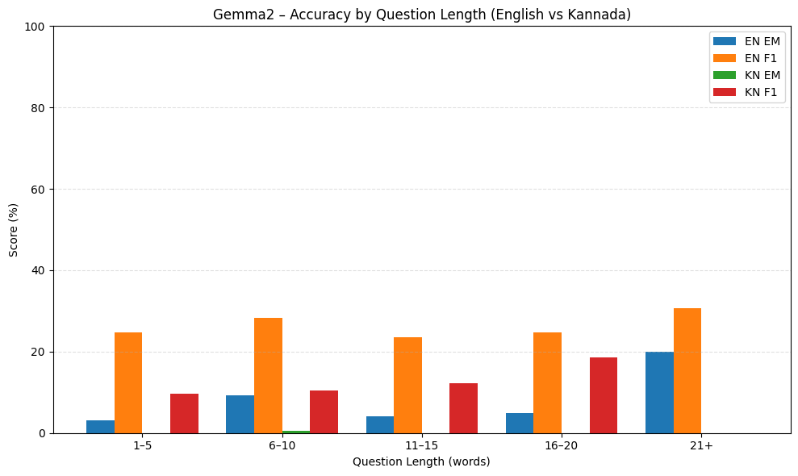
Lost in Translation?
Model - 3 - Gemma2 - Kannada
Modelling
Base model: Gemma-2B-IT, an instruction-tuned decoder LLM.
Used LoRA fine-tuning targeting q/k/v/o projection layers → only 0.24% trainable parameters (~6.38M).
Training setup: 2 epochs, LR = 2e-5, BF16 on A100, cosine LR schedule, gradient accumulation (effective batch = 16).
Created bilingual model capable of answering questions in both English and Kannada using the same instruction framework.
Inference optimized using greedy decoding + caching, reducing evaluation time significantly.
Pre-processing
Started with 130k bilingual SQuAD-style examples (English + Kannada translations).
Filtered out impossible questions and created instruction-style prompts for both languages.
English format: “You are a helpful assistant… Context… Question… Answer…”
Kannada format mirrored the same structure in native script, ensuring cultural/linguistic fidelity.
Tokenized using Gemma tokenizer (SPM) at max length 512; EOS token substituted as padding.
Final training set: 138,821 instruction samples (English + Kannada combined).

Slide 10
SWOT
Lost in Translation?
Inference, Insights & Results
Gemma vs. MURIL: A Tale of Two Architectures
STRENGTHS
WEAKNESSES
Why MURIL Performs Better for Kannada
Key Takeaways
Shows moderate English performance (F1 ~25–28%), indicating good semantic alignment on extractive tasks.
Efficient training with parameter-efficient LoRA: fast, stable, and resource-friendly.
Capable of generating context-aware, fluent answers even when ground-truth spans vary in structure.
Very low Kannada performance (EM ≈ 0%, F1 ~9–12%).
Decoder-style generation → struggles to reproduce exact spans, causing low EM.
Tokenization mismatch: Gemma’s SentencePiece fragments Kannada words heavily → weak lexical grounding.
Tends to hallucinate or over-generate, especially for longer Kannada contexts.
Bilingual training biases the model heavily toward English.
MURIL is pretrained extensively on Indian-language corpora, including large volumes of Kannada text.
Designed as a BERT-style encoder → naturally suited for extractive QA with start–end span prediction.
Uses a vocabulary optimized for Indic scripts, producing cleaner subword segmentation.
Strong baseline representation for Dravidian languages → less drift and fewer hallucinations.
Gemma2 can be adapted to Kannada, but pretraining limitations + generative architecture restrict its extractive QA performance.
For Indian-language QA, especially Kannada, MURIL remains significantly stronger due to language-specific pretraining and architecture.
Future improvements: Kannada-only finetuning, tokenizer adaptation, or switching to multilingual encoder/seq2seq architectures (mT5, IndicBERT).

Slide 11
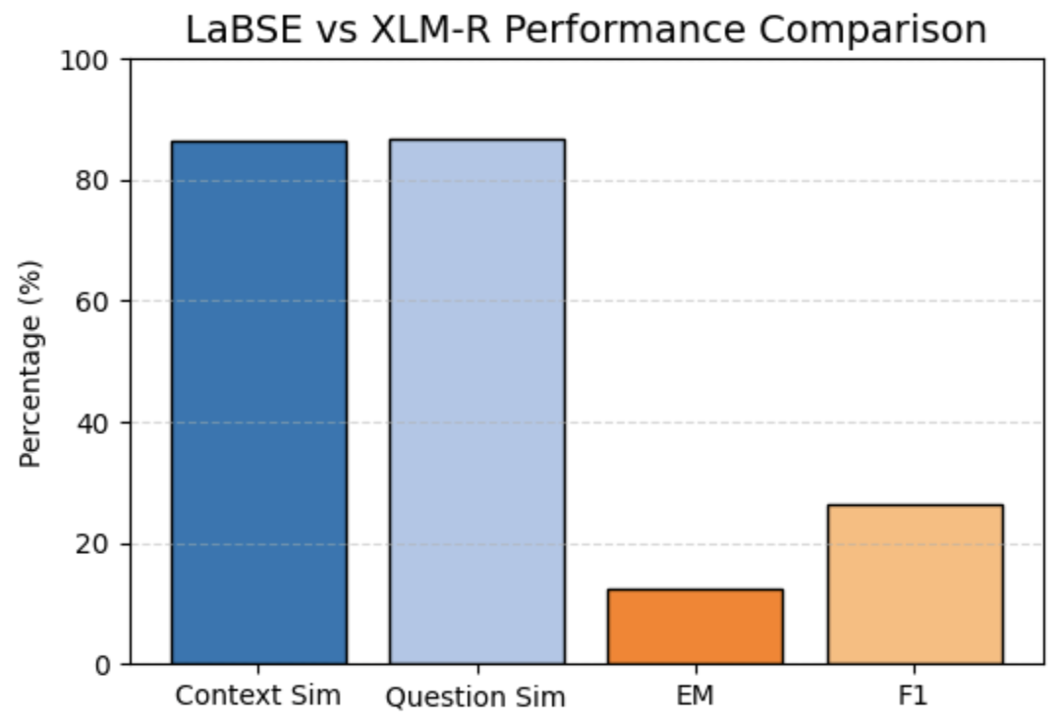
Lost in Translation?
Model - 4 - LaBSE - Hindi
Modelling
Fine-tuned XLM-RoBERTa-base as an extractive QA model predicting start/end answer spans.
Model trained only on LaBSE-validated, span-aligned Hindi samples.
Evaluated performance on clean Hindi dev samples with reliable span grounding.
  Exact Match (EM): 12.30%
  F1 Score: 26.55%
Showcased how translation structure influences extractive performance in multilingual QA.
Pre-processing and Modelling
Pre-processing
Translated all SQuAD contexts, questions, and answers into Hindi using NLLB-200 (600M).
Evaluated translation fidelity using LaBSE, computing semantic similarity scores for English ↔ Hindi pairs.
  Contexts = 0.865
  Questions = 0.868
Used LaBSE scores to confirm that meaning was preserved before modelling.
Applied fuzzy span alignment to recover Hindi answer locations inside contexts.
Retained only high-quality, span-recoverable samples → 77,016 train and 5,283 validation examples.
Tokenized the dataset with XLM-R multilingual subword tokenizer.

Slide 12
Inference, Insights & Results
STRENGTHS
WEAKNESSES
OPPORTUNITIES
THREATS
LaBSE confirms high semantic consistency, ensuring accurate meaning transfer.
Strong contextual preservation enables clear comprehension in Hindi.
XLM-R handles Hindi script and morphology efficiently.
The dataset supports large-scale cross-lingual QA experimentation.
Exact span mismatch lowers extractive QA accuracy despite semantic fidelity. Many translated answers do not appear verbatim in contexts.
Surface-form variation reduces EM/F1 during evaluation.
Some Hindi contexts introduce subtle alignment drifts.
Move to mT5 generative QA, eliminating span dependence entirely.
Combine LaBSE + token-level similarity for deeper alignment improvement.
Explore larger multilingual models for Hindi extractive QA improvements.
Extend pipeline to multi-Indic QA datasets and cross-lingual benchmarks.
Translation variability may distort factual precision over long contexts.
Extractive QA remains fragile when spans transform morphologically.
Risk of lower generalization on native Hindi datasets (not translated).
Higher translation noise could shrink the effective training set further.

Slide 13
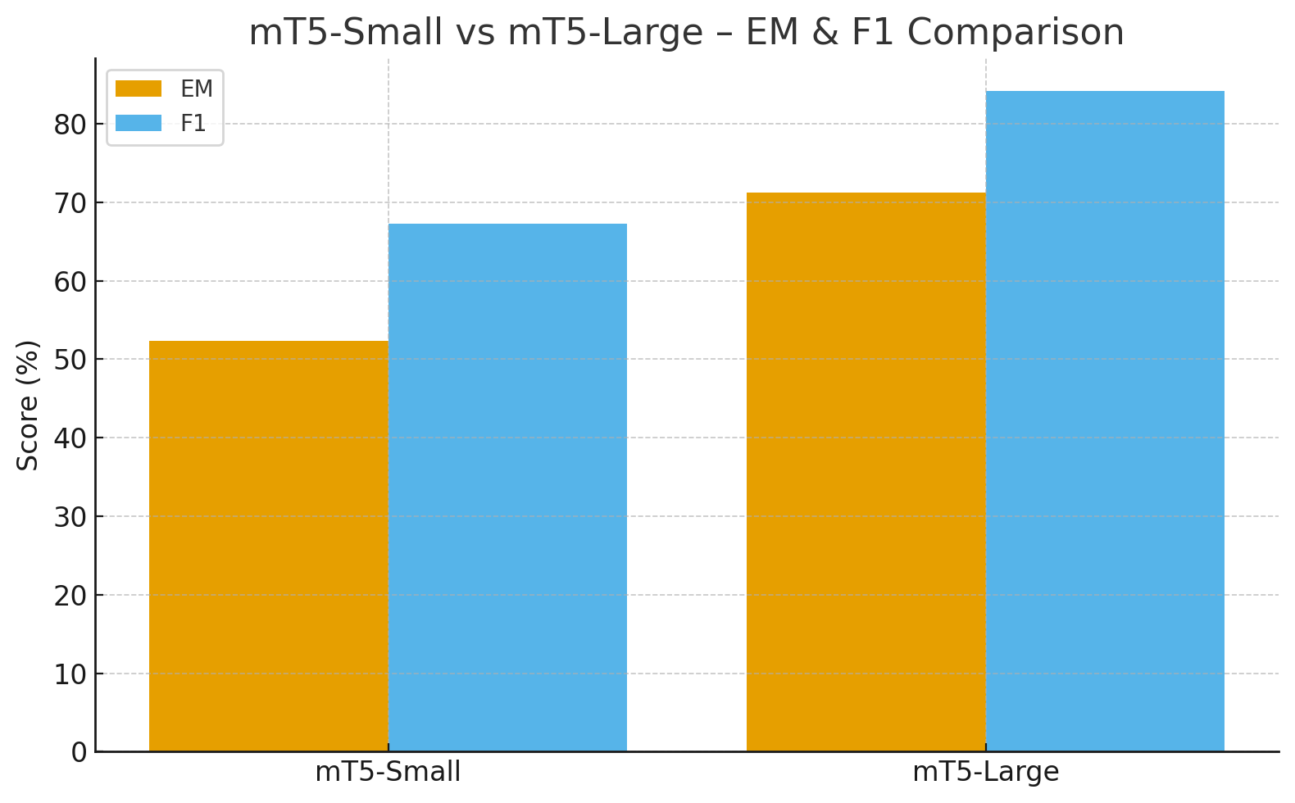
Model - 5 - mT5 - Urdu
Modelling — mT5 Small & Large
mT5-Large
• High-capacity multilingual transformer with stronger Urdu representations.
• More accurate on long contexts, complex sentences, and morphologically rich Urdu forms.
• Generates cleaner, span-like answers with fewer hallucinations and less paraphrasing.
• Shows major improvement in EM/F1 due to better retention of exact Urdu phrases.
• Stable across different question lengths, especially mid-long questions.
mT5-Small
• Lightweight multilingual seq-to-seq model used as the baseline for Urdu QA.
• Trained on Urdu-only SQuAD text-to-text prompts (سوال + متن → جواب).
• Handles shorter contexts well but struggles with long passages and entity-heavy answers.
• Tends to paraphrase or add extra words, leading to lower Exact Match even when F1 is decent.
Pre-processing and Modelling
Started with 130k SQuAD v2.0 English samples
Translated to Urdu using NLLB-200 (600M) → context, question, answer
Translation done in 7 safe chunks (A–G), GPU-accelerated via MPS
Cleaned and validated the Urdu corpus
Converted to final SQuAD-style Urdu JSON files:
  train.json
  dev.json
Filtered out unanswerable samples for training
Input format used during fine-tuning:
“سوال: متن: ”

Slide 14
Inference, Insights & Results
WHY mT5-LARGE - BETTER
STRENGTHS
Much deeper multilingual pretraining → stronger Urdu representations
Larger capacity improves semantic alignment between question & context
More resistant to hallucination / over-generation
Better at precise span recovery (higher EM)
Stable performance across short, medium, and long questions
Strong Urdu QA performance despite being a low-resource language
mT5-Large achieves very high scores:
EM: 71.26%, F1: 84.20%
mT5 models generate fluent, grammatically natural Urdu responses
Urdu morphology is handled well, especially in mT5-Large (fewer hallucinations)
Consistent improvements across question lengths and difficulty levels
WEAKNESSES
KEY TAKEAWAYS
mT5-Small struggles with long contexts or complex entities
Generative nature → sometimes paraphrases instead of copying exact span
Occasional trailing text or partial-sentence outputs (hurts EM score)
Sensitive to translation noise in Urdu contexts (NLLB minor drift effects)
mT5-Large is the strongest Urdu QA model in our 5-language pipeline
Generative transformers (mT5) outperform encoder-only baselines in fluency
Fine-tuning with Urdu-only SQuAD JSON helps preserve extractive structure
Future improvements:
LoRA training for mT5-XL
Urdu-specific normalization
Span-guided decoding for tighter EM alignment

Slide 15
Lost in Translation?
Conclusion & Future Work
Translation Quality Bottleneck:
23% answer misalignment from independent translation creates performance ceiling—data quality matters as much as model architecture
Architecture-Language Match:
Generative models (mT5-Large: 71% EM) outperform extractive models for morphologically complex languages; best architecture depends on linguistic typology
Post-Processing & Native Data:
Implement fuzzy matching for answer alignment, develop language-specific tokenizers, create native Indic QA benchmarks to eliminate translation artifacts

Slide 16
Lost in Translation?
THANK YOU
Any questions?

